Slide 1
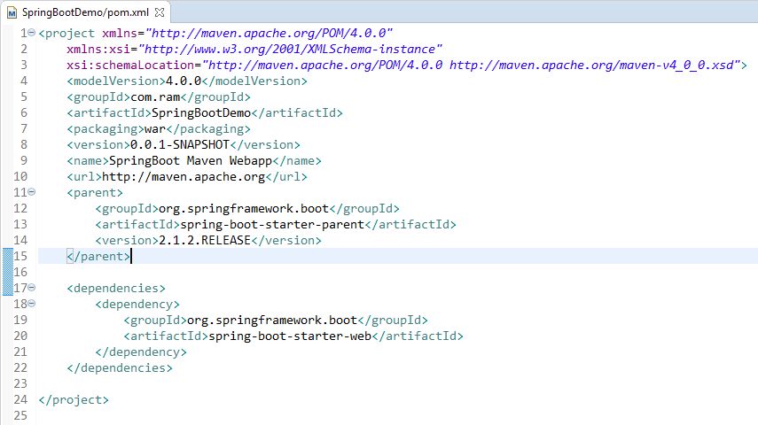
Spring Boot – Runners [Application Runner]
BOM stands for Bill Of Materials. A BOM is a special kind of POM that is used to control the versions of a project’s dependencies and provide a central place to define and update those versions.
BOM provides the flexibility to add a dependency to our module without worrying about the version that we should depend on.
You can think of a BOM project as a dependency directory that declares all the related projects versions thus save your version resolution efforts.
Once your BOM imported into your project descriptor, you no more need to declare the version when declaring a dependency because it will be inherited from that imported pom.

